Slide 1
FAIRsFAIR in a Nutshell
March 2021

Slide 2






















FAIRsFAIR partners
Notes:
FAIRsFAIR is a coming together of actors from all across Europe. Importance of coming together … “..we will only be able to succeed in making the EOSC a reality, if we all come together and work together..” Cathrin Stover, EOSC Executive Board Vice Chair (Feb, 2019)

Slide 3

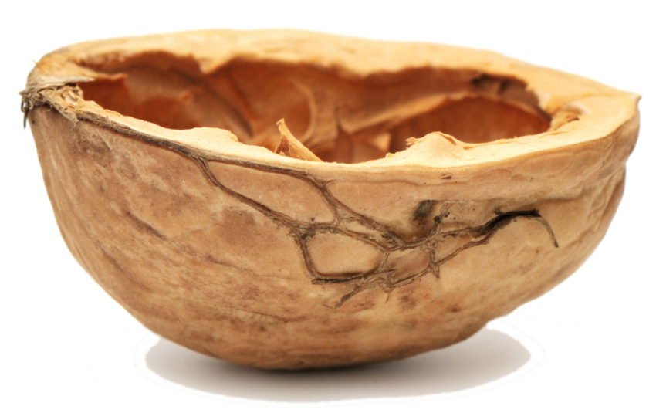



FAIRsFAIR in a nutshell
Call: H2020-INFRAEOSC-5c
Budget: 10 million euro
Length: 36 months
Starting date: March 1 2019
22 partners from 8 MS
6 core partners
© Marjan Grootveld

Slide 4
Our objective
Help survey the landscape of FAIR activities in relation to EOSC and identify where dialogue and collaboration can be encouraged.
Create a basis for harmonisation efforts to bring together the various actors working in the FAIR ecosystem and build a functioning EOSC and active community around EOSC.

Slide 5

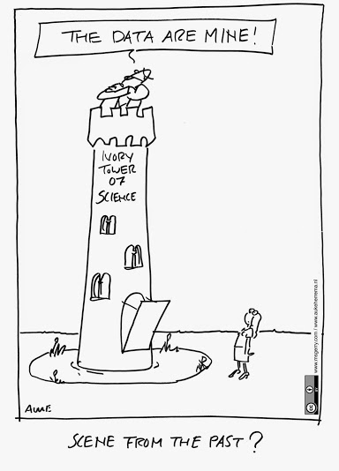
Overall project aim
FAIRsFAIR addresses the development and concrete realisation of an overall knowledge infrastructure on academic quality data management, procedures, standards, metrics and related matters based on the FAIR data principles
  The objective is to accelerate the realization of the goals of the EOSC by opening up and sharing all knowledge, expertise, guidelines, implementations, new trajectories, courses and education on FAIR matters
Implementation of recommendations from the EOSC HLEG and the Expert Group on FAIR Data

Slide 6
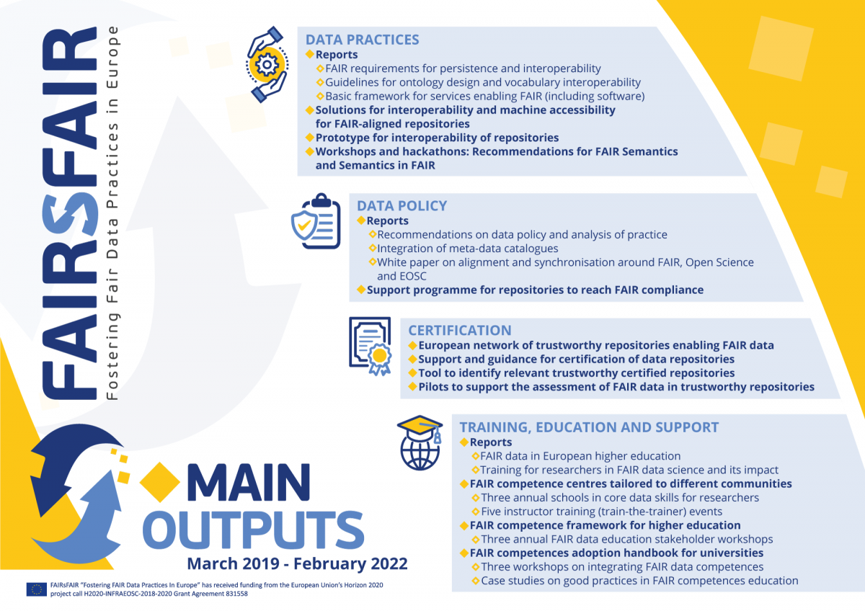

Slide 7
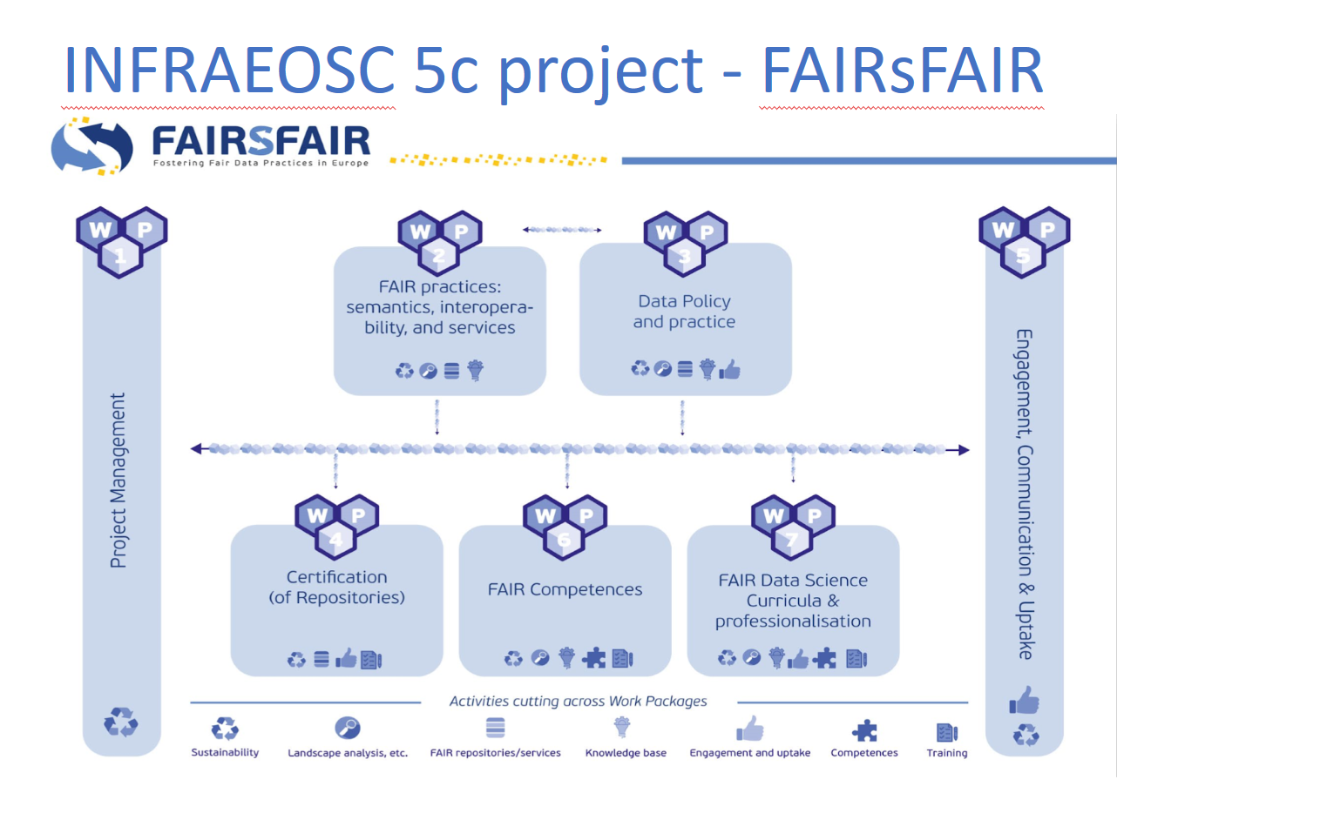
Work Packages
© Marjan Grootveld
Notes:
In the first SynchForce workshop in Budapest (November 2019) we undertook a mapping of the Packages <-> EOSC Working Groups. That was challenging, because FAIR cuts across everything.

Slide 8
FAIR Semantics, Interoperability and Services
FAIRsFAIR is working actively to produce recommendations on technologies that support semantic interoperability in a sustainable way, and practices that support FAIRness.
Improve the semantic interoperability of research resources by specifying FAIR metadata schemas, vocabularies, protocols, and ontologies
Provide solutions for interoperability requirements and machine accessibility for FAIR-aligned repositories
Formulate guidelines and recommendations for FAIR-enabling services
Assess to what extent the FAIR principles can be applied to research software
February 2020 Assessment report on FAIRness of services https://doi.org/10.5281/zenodo.3688762
August 2020 2nd Report on FAIR requirements for persistence and interoperability describes the use of PIDs and metadata to enable FAIR data https://doi.org/10.5281/zenodo.4001631
October 2020 Assessment report on FAIRness of research software
https://doi.org/10.5281/zenodo.4095091
December 2020 Second iteration of Recommendations for FAIR Semantics https://doi.org/10.5281/zenodo.4314320
November 2020 Basic Framework Fairness of Services https://doi.org/10.5281/zenodo.4292598
February 2021 The FAIR Data Point prototype https://doi.org/10.5281/zenodo.4501201
Contact: Jessica Parland jessica.parland-vonessen@csc.fi

Slide 9
FAIR Policy and Practice
The overall aim is to increase the production and use of FAIR data by supporting changes in policy and practice at funding body, repository and organisational levels.
FAIRsFAIR team are working with stakeholders to provide recommendations on how policies might be enhanced to support FAIR.
Collaboratively work to define recommendations and embed FAIR data practice in research culture
Develop a support programme to help repositories become more FAIR-enabling
February 2020 Policy Enhancement Recommendations https://zenodo.org/record/3686901
June 2020 Recommendations on practice to support FAIR data principles) https://zenodo.org/record/3924132
September 2020 Description of FAIRsFAIR's Transition Support Programme for Repositories
https://doi.org/10.5281/zenodo.4058339
October 2020 Proposal on integration of metadata catalogues to support cross-disciplinary FAIR uptake
https://doi.org/10.5281/zenodo.4134787
Contact: Joy Davidson Joy.Davidson@glasgow.ac.uk

Slide 10
FAIR Certification
FAIRsFAIR takes an iterative approach to aligning FAIR object assessment with existing CoreTrustSeal requirements. This FAIR oriented elaboration of core TDR requirements provides input for the testing and revision of repository evaluation in the EOSC.
FAIR Objects → FAIRness evaluations of individual datasets. Use case based iterative approach building on existing work: researchers and data repositories
FAIR-enabling repositories → to support the co-development and implementation of certification schemes for data repositories, building on existing frameworks
FAIR object and data repository complementarity
Wider range of standard/assessment expectations (e.g. services, software, etc.) → keen to align and with other criteria that might be set for involvement in the EOSC, e.g. minimal technical standards.
The FAIRsFAIR Certification programme supports ten selected repositories in achieving CoreTrustSeal Certification.
blogpost (October 2020), newspiece (February 2021)
February 2020: FAIR objects: - Draft recommendations on requirements for FAIR datasets in trustworthy repositories https://zenodo.org/record/3678716
May 2020: FAIR-enabling repositories: Initial version of a repository certification mechanism: evaluations for CoreTrustSeal, implications for maturity modeling. Open to extensive engagement, feedback and iterations afterwards https://zenodo.org/record/3835698
August 2020 Further work on the FAIR Maturity work, building on this working paper
November 2020 and February 2021 Support workshops for the FAIR Certification Support programme
Contact: Ilona von Stein ilona.von.stein@dans.knaw.nl
Notes:
D4.2 This paper sets the work within the wider context of data infrastructures, describes the co-dependencies between (meta) data objects and their repository environment, and presents the developing mapping between requirements and principles. The evolving capability/maturity approach is explained and the design of a governed assessment and certification process is defined. This work will iterate alongside the wide range of ongoing data infrastructure initiatives to support a range of stakeholders on their journey towards trustworthy repository services that enable FAIR data. Extensive engagement and feedback are planned to allow us to reach this goal.

Slide 11
FAIR Data Science and Professionalisation
Objectives
Map the integration of FAIR data principles in data science and other disciplines’ curricula and analyse the landscape of available FAIR data trainings in Europe.
Deliver a FAIR data competence framework for higher education and professionals to support the development of a FAIR data culture and the uptake of FAIR data principles.
Translate the competence framework into model curricula and university courses for different disciplines and professional profiles (e.g. data stewards)
Support embedding FAIR data education in university programmes and doctoral training through a series of workshops.
Main outputs
Survey and report of FAIR data landscape (education, policies and support) at 90 universities across Europe: https://doi.org/10.5281/zenodo.3629682
Overview and analysis of existing competence frameworks and training initiatives: https://doi.org/10.5281/zenodo.4009006
FAIR Competence Framework published https://doi.org/10.5281/zenodo.4009007
Main activities
Focus groups held with 50 experts at University Carlos III of Madrid and the University of Amsterdam
Design Workshop for “FAIR Competence Framework for Higher Education”
Workshop on role of academic libraries in RDM and FAIR training: https://zenodo.org/record/3929098
FAIR Competence Centre launched
Contact: Bregt Saenen bregt.saenen@eua.eu

Slide 12
FAIR Competence Centre
“A shared hub of expertise in implementing FAIR data stewardship principles, offering leadership, coordination and cataloguing services to connect relevant people, guidance, learning resources and curricula”
Supports a range of communities in their activities aimed at FAIR data uptake and compliance.
Promotes harmonisation and coordination of efforts across communities, identifying opportunities for synergies and building on the progress of others. For example: contributing to development of Terms4FAIRskills terminology.
Delivers data stewardship training building on the CODATA-RDA Summer School for Research Data Science
Contact: Elizabeth Newbold elizabeth.newbold@stfc.ac.uk

Slide 13








The FAIR Data Point (FDP)
Sandbox running, reference implementation upcoming
Semantic inter-
operability
Prototype
GUI
API
D2.6
Notes:
Repository can expose its meta data to protype
Expose (Meta) Data Model structured (in machine-readable form)
Reuse & Implementation of community standards With T2.2.! (Yann will explain that)
Mention that WP3 will package up some of the practical experience from the sandbox work to make some guidance on the potential value of the FDP for repositories not supported through the open call

Slide 14

Online tool which helps researchers and data managers assess, with 19 questions, how much they know about the requirements for making datasets FAIR before uploading them into a data repository.
TRY THE TOOL
https://www.fairsfair.eu/fair-aware

Slide 15

An online FAIRness assessment of published research datasets. The tool is based on 14 out of 15 core FAIR object assessment metrics developed within the project.
F-UJI adheres to existing web standards and PID resolution services best practices and utilises external registries and resources such as re3data and Datacite APIs, SPDX License List, RDA Metadata Standards Catalog, and Linked Open Vocabularies (LOV).
TRY THE TOOL
https://www.fairsfair.eu/f-uji-automated-fair-data-assessment-tool

Slide 16

Fifteen minimum viable metrics proposed by FAIRsFAIR for the systematic assessment of FAIR data objects. These metrics are based on indicators proposed by the RDA FAIR Data Maturity Model Working Group, on the WDS/RDA Assessment of Data Fitness for Use checklist, and on prior work conducted by project partners such as FAIRdat and FAIREnough
LEARN MORE
https://www.fairsfair.eu/fairsfair-data-object-assessment-metrics-request-comments

Slide 17
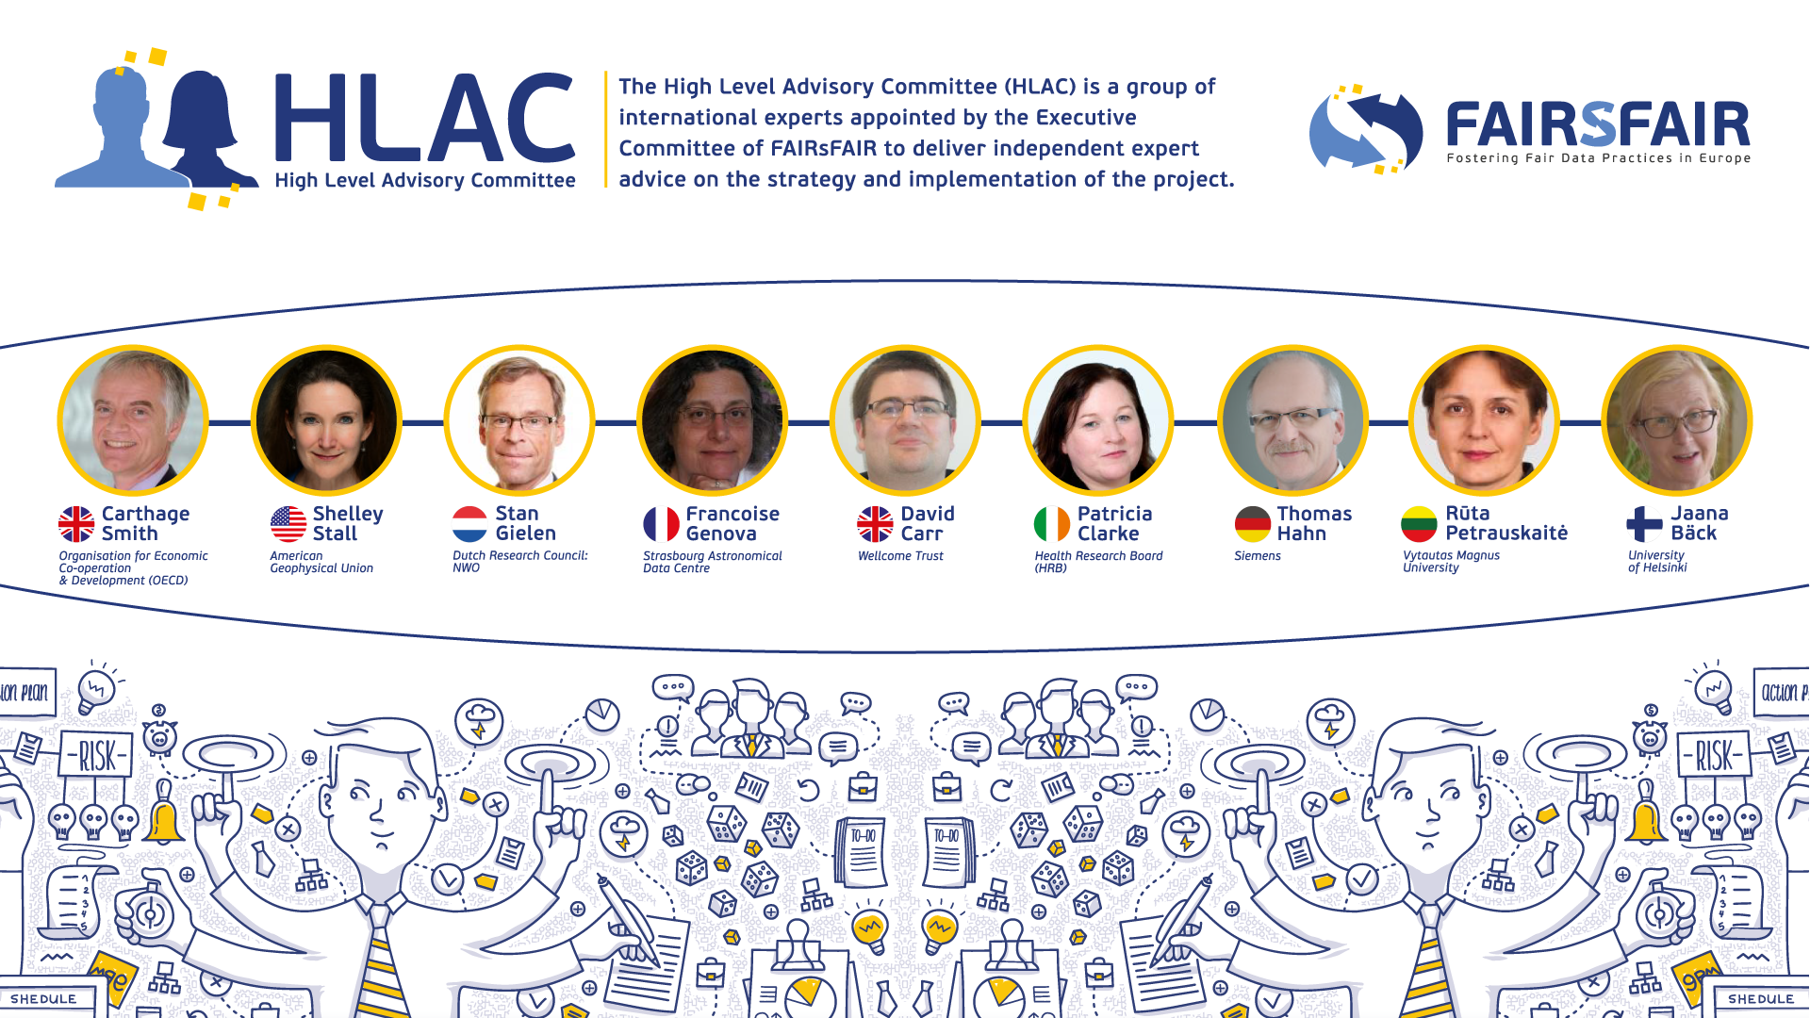

Slide 18
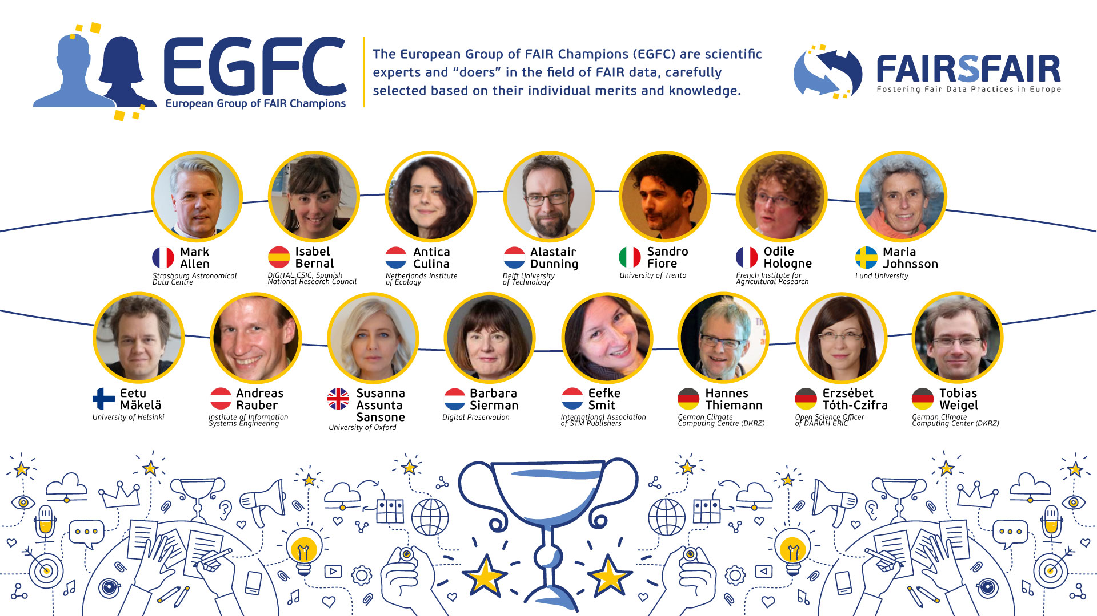
Notes:
Important outreach is achieved by working collaboration with the European Group of FAIR Champions.
The European Group of FAIR Champions (EGFC) is composed by scientific experts and “doers” in the field of FAIR data, carefully selected based on their individual merits and knowledge. The group works as an ambassador of FAIR by sharing FAIR implementation stories, enhancing synergies, contributing to training activities and webinars, and doing an effective cross fertilization with other communities, towards a broader engagement on FAIR.
Each EGFC member represents FAIRsFAIR stakeholders and provides advice on operational challenges, as well as promotes new policies to improve the adoption of policies for FAIR data which supports the EOSC and the FAIR data policy and practice. Their inputs will be included into the FAIR Landscape Analysis and white papers authored by FAIRsFAIR.

Slide 19


Establishing a dialogue among the various projects and actors in the EOSC Ecosystem whose work touches on FAIR in order to:
Maximise coordination & minimise unnecessary overlap or duplication
Encourage the dovetailing of project activities with EOSC governance
Promote mechanisms to collaborate on turning FAIR into reality
© Marjan Grootveld
Notes:
Another solution...the Synchronisation Force… It is an internal group in which all FsF WPs are represented.
...
The key activity of the SF is to organise three workshops. More about it in a minute. First a few words about other activities, because several SF members are involved in so-called TaskForces under the INFRAEOSC-5 Cross Project Collaboration Board.

Slide 20
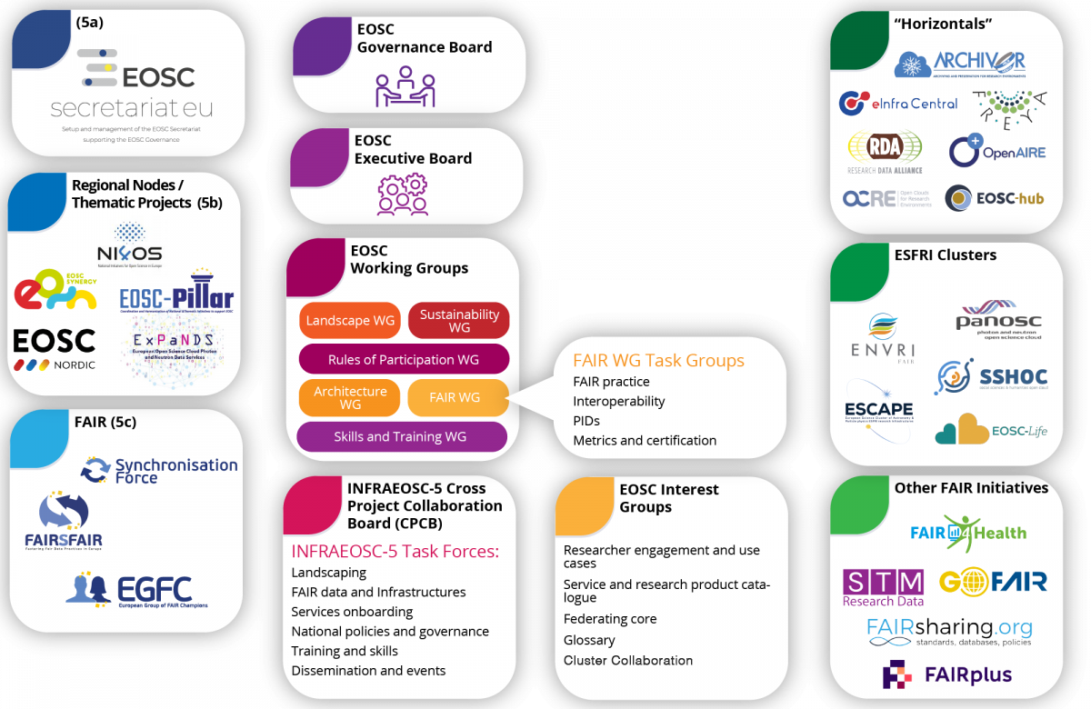
Primary stakeholders in the EOSC Ecosystem
Notes:
It is not just as easy as abc. There are no lines connecting these boxes because the reality is that the EOSC ecosystem is a complex network of actors and initiatives. Futhermore FAIR IS EVERYWHERE. The Synchronisation Force aims to provide beneficial input for the EOSC Working Groups, as well as the five ESFRI Clusters (PANOSC, SSHOC, ENVRI-FAIR, ESCAPE and EOSC-Life), and the other INFRAEOSC-5 projects, and Horizontal projects e.g. EOSChub and Freya. They are aided in this work by our Expert Group of FAIR Champions (EGFC) who act as ambassadors for FAIR in their own networks and communities.
I’ll show you the current members of the group and then I’ll introduce the Synch Force.

Slide 21
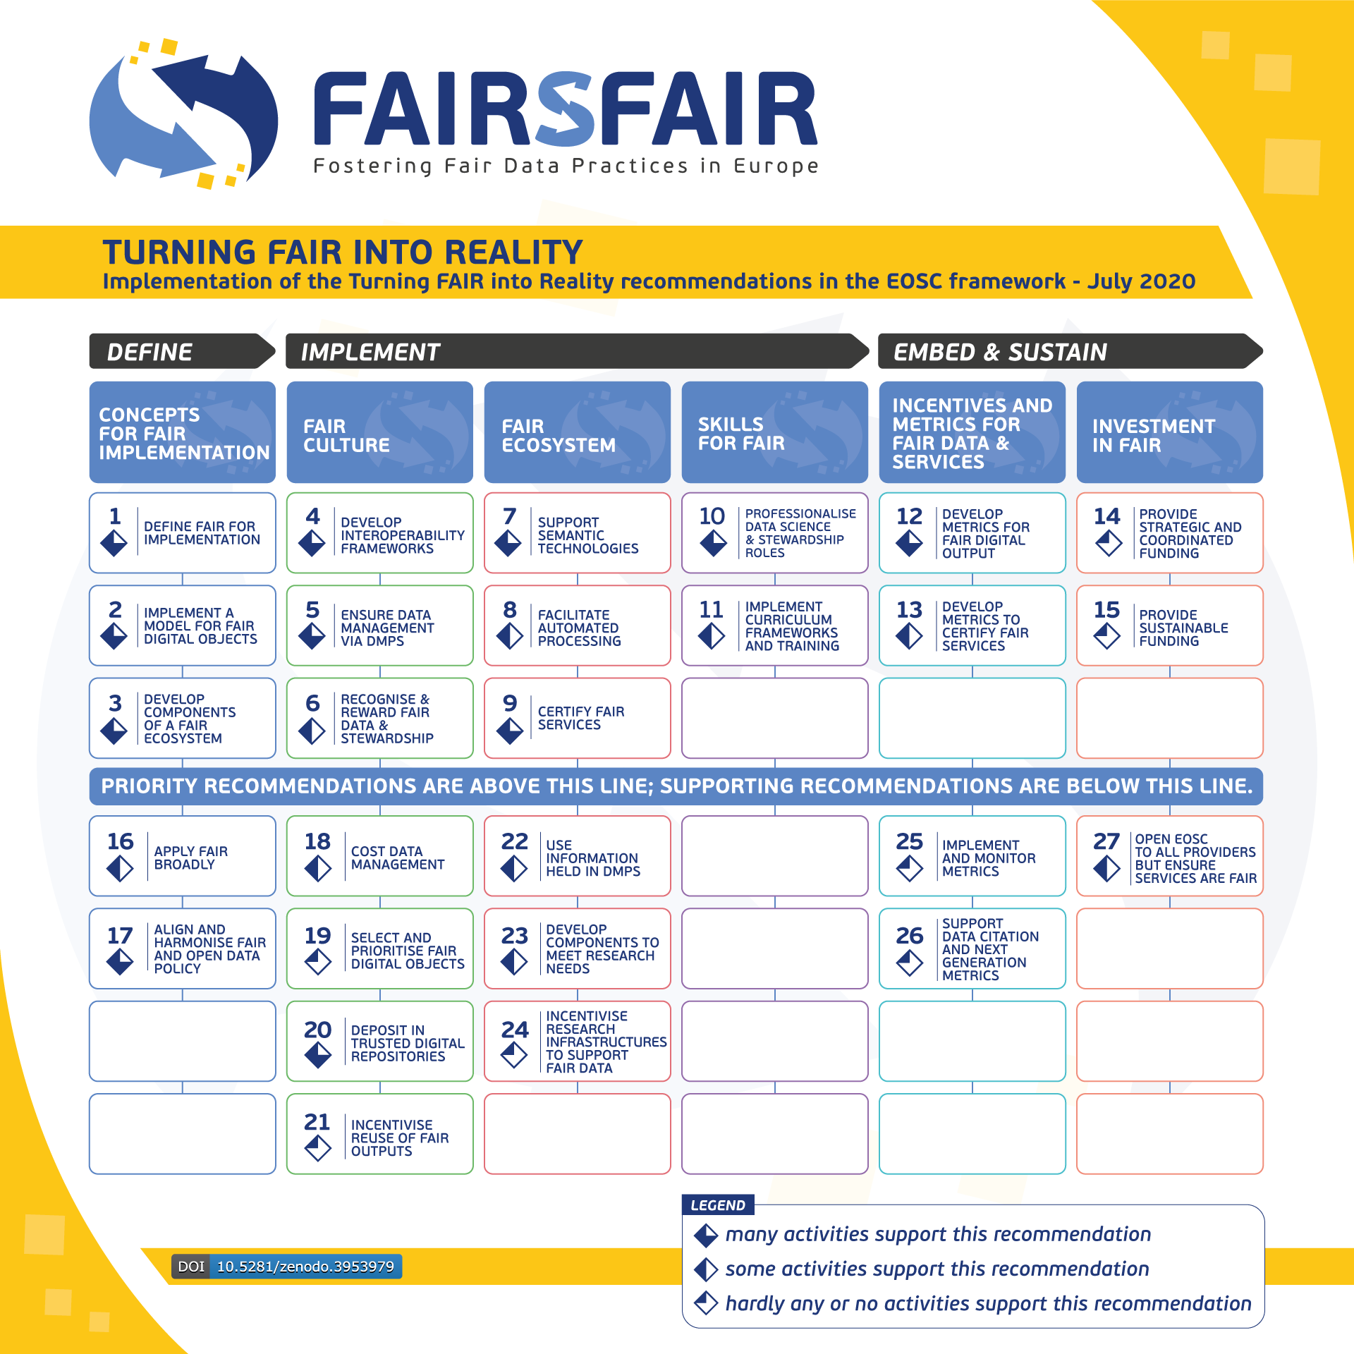
Second Workshop
Between 29 April and 11 June 2020 FAIRsFAIR brought together the EOSC Working Groups, INFRAEOSC5 projects, ESFRI clusters, and the FAIR Champions to share information on the progress of FAIR-oriented activities and to discuss commonalities and priorities.
On 3 September 2020 Ingrid Dillo and Marjan Grootveld presented a report on the workshop outcomes at the EOSC FAIR Working Group meeting.
Key Recommendations
EOSC Governance to facilitate additional activities in under-represented areas (Recommendations 6, 8, 11, 13) through EOSC co-creation, Horizon Europe funding or other initiatives
Supporting recommendation 23 to be reclassified as a priority recommendation
Gaps to be addressed in the Turning FAIR into Reality Action Plan
► Workshop recordings and presentations
► Report
► Summary Overview
Notes:
The outcomes of the workshop show that the original 27 TFiR recommendations are still very relevant and constitute a useful benchmark for measuring how projects and EOSC Working Groups progress towards turning FAIR into reality. During the workshop, participants agreed that the EOSC-related projects, working groups, and FAIR Champions are contributing in significant degree to the implementation of many of the TFiR recommendations.
On 3 September 2020 Ingrid Dillo and Marjan Grootveld presented a report on the workshop outcomes at the EOSC FAIR Working Group meeting. The document was well received by the WG, and will be taken it into consideration in the writing of the Interim recommendations for FAIR metrics and service certification report, currently in its final phase.

Slide 22

The third workshop
The third Synchronisation Force Workshop is planned to take place from 3 May 2021 to 11 June 2021, to take another and final snapshot of the status of the implementation of the recommendations from the Turning FAIR into Reality report.
In preparing for that workshop, FAIRsFAIR will also consider how better to engage the horizontal e-infrastructure projects and the ESFRI cluster projects as well as the EOSC Association

Slide 23
You as FAIRsFAIR ambassador
FAIRsFAIR in a Nutshell https://www.fairsfair.eu/fairsfair-nutshell
Useful materials for sharing & distribution
About FAIRsFAIR
FAIRsFAIR, Fostering FAIR Data Culture & Practices in Europe Flyer, March 2019
FAIRsFAIR main outputs. Infographics, September 2019
Embracing a FAIR Culture. FAIRsFAIR poster at the EOSC-Hub week. May 2020
FAIRsFAIR & EOSC infographic
FAIRsFAIR deposited outputs are periodically added to the FAIRsFAIR community on Zenodo
FAIRsFAIR Readings
FAIRsFAIR documents for community review
Deliverables and milestones
Presentations
Articles and blogposts
Newsletters
Other Outputs
For dissemination & social media share
FAIRsFAIR videos
FAIRsFAIR podcasts
Twitter channel
LinkedIn page
Youtube account
FAIRsFAIR standard logo (png)
FAIRsFAIR square logo (png)
FAIRsFAIR Software & Tools
FAIR Aware
FAIR Data Object Assessment Metrics
F-UJI

Slide 24




FOLLOW US
www.fairsfair.eu
@FAIRsFAIR_eu
www.linkedin.com/company/fairsfair/
www.youtube.com/channel/UCE4wSBnNIBfu6SqlBaIMfNg

