Slide 3
FAIRsFAIR in a Nutshell
October 2020

Slide 4






















FAIRsFAIR partners
Notes:
FAIRsFAIR is a coming together of actors from all across Europe. Importance of coming together … “..we will only be able to succeed in making the EOSC a reality, if we all come together and work together..” Cathrin Stover, EOSC Executive Board Vice Chair (Feb, 2019)

Slide 5

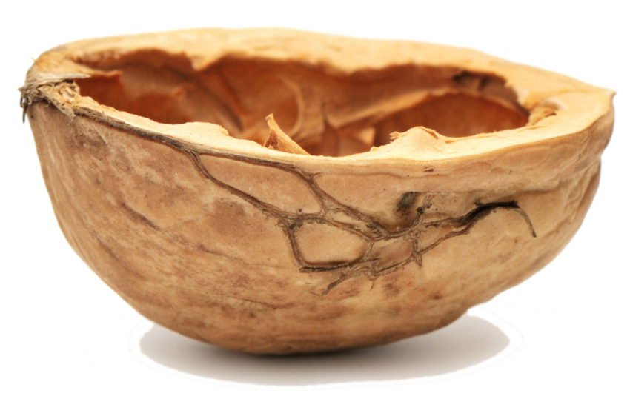



FAIRsFAIR in a nutshell
Call: H2020-INFRAEOSC-5c
Budget: 10 million euro
Length: 36 months
Starting date: March 1 2019
22 partners from 8 MS
6 core partners
© Marjan Grootveld

Slide 6
Our objective
Help survey the landscape of FAIR activities in relation to EOSC and identify where dialogue and collaboration can be encouraged.
Create a basis for harmonisation efforts to bring together the various actors working in the FAIR ecosystem and build a functioning EOSC and active community around EOSC.

Slide 7
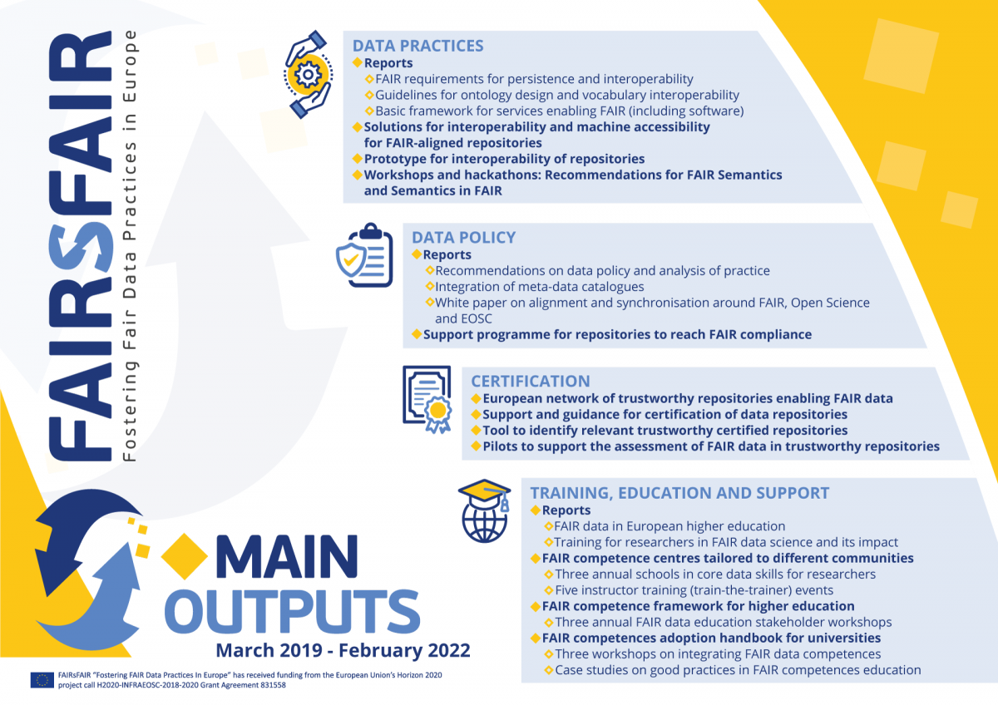

Slide 8
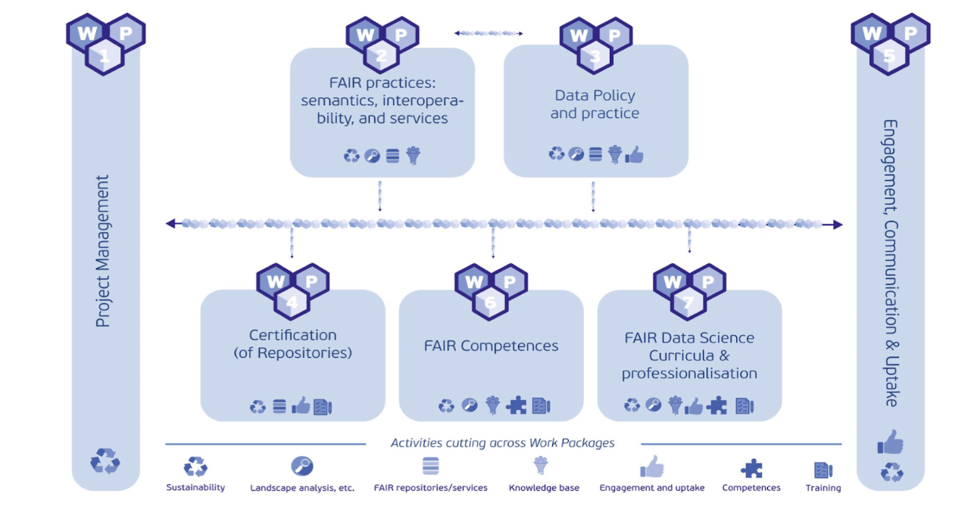
Work Packages
© Marjan Grootveld
Notes:
In the first SynchForce workshop in Budapest (November 2019) we undertook a mapping of the Packages <-> EOSC Working Groups. That was challenging, because FAIR cuts across everything.

Slide 9

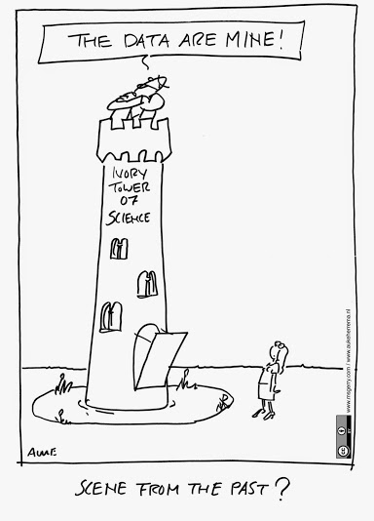
Overall project aim
’FAIRsFAIR addresses the development and concrete realisation of an overall knowledge infrastructure on academic quality data management, procedures, standards, metrics and related matters based on the FAIR data principles’;
  ‘The objective is to accelerate the realization of the goals of the EOSC by opening up and sharing all knowledge, expertise, guidelines, implementations, new trajectories, courses and education on FAIR matters’;
Implementation of recommendations from the EOSC HLEG and the Expert Group on FAIR Data.

Slide 10

Online tool which helps researchers and data managers assess, with 19 questions, how much they know about the requirements for making datasets FAIR before uploading them into a data repository.
TRY THE TOOL
https://www.fairsfair.eu/fair-aware

Slide 11

An online FAIRness assessment of published research datasets. The tool is based on 14 out of 15 core FAIR object assessment metrics developed within the project.
F-UJI adheres to existing web standards and PID resolution services best practices and utilises external registries and resources such as re3data and Datacite APIs, SPDX License List, RDA Metadata Standards Catalog, and Linked Open Vocabularies (LOV).
TRY THE TOOL
https://www.fairsfair.eu/f-uji-automated-fair-data-assessment-tool

Slide 12

Fifteen minimum viable metrics proposed by FAIRsFAIR for the systematic assessment of FAIR data objects. These metrics are based on indicators proposed by the RDA FAIR Data Maturity Model Working Group, on the WDS/RDA Assessment of Data Fitness for Use checklist, and on prior work conducted by project partners such as FAIRdat and FAIREnough
LEARN MORE
https://www.fairsfair.eu/fairsfair-data-object-assessment-metrics-request-comments

Slide 13
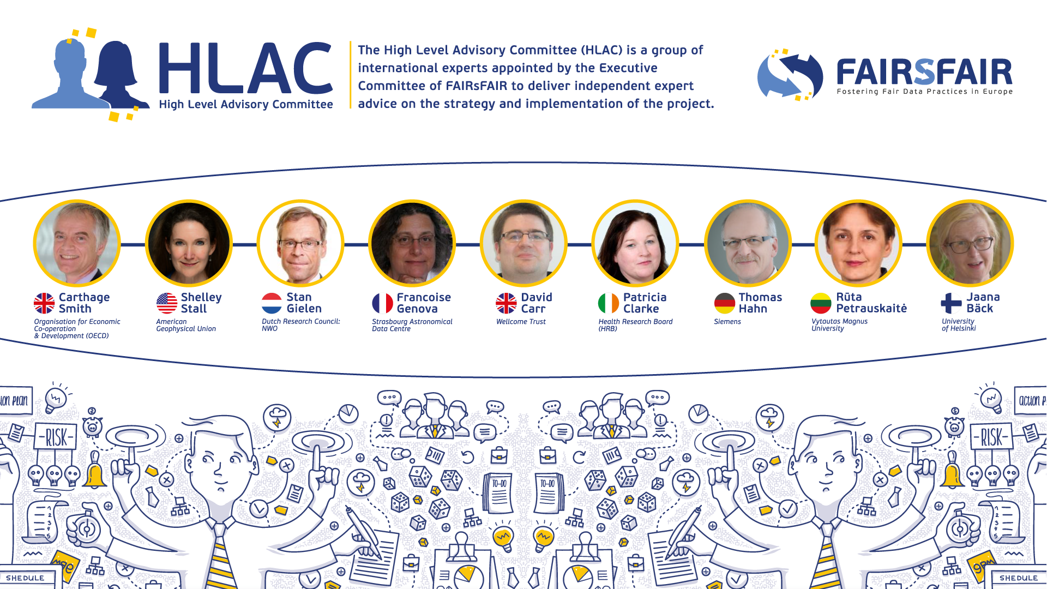

Slide 14
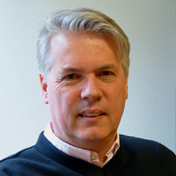
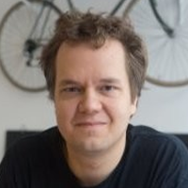

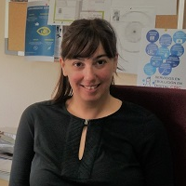
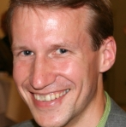
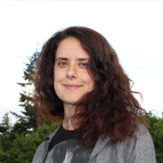
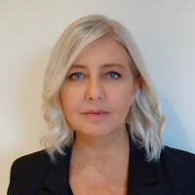
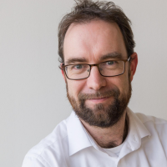
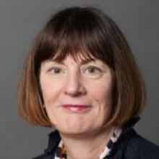
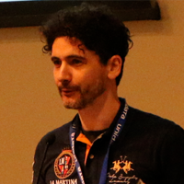
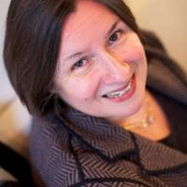
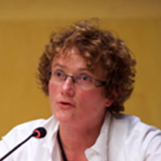
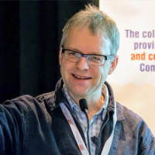
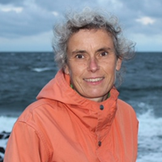
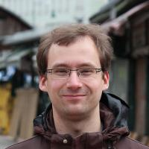
European Group of FAIR Champions
Mark Allen
Affiliation: Strasbourg Astronomical Data Centre
Country: France
Eetu Mäkelä
Affiliation: University of Helsinki
Country: Finland
Isabel Bernal
Affiliation: DIGITAL.CSIC
Country: Spain
Andreas Rauber
Affiliation: Tech Uni Vienna
Country: Austria
Antica Culina
Affiliation: Netherlands Institute of Ecology
Country: Netherlands
Susanna-Assunta Sansone
Affiliation: University of Oxford
Country: United Kingdom
Alastair Dunning
Affiliation: Delft University of Technology
Country: Netherlands
Barbara Sierman
Affiliation: Digital Preservation
Country: Netherlands
Sandro Fiore
Affiliation: University of Trento
Country: Italy
Eefke Smit
Affiliation: International Association of STM Publishers
Country: Netherlands
Odile Hologne
Affiliation: French Institute for Agricultural Research
Country: France
Hannes Thiemann
Affiliation: German Climate Computing Centre (DKRZ)
Country: Germany
Maria Johnsson
Affiliation: Lund University
Country: Sweden
Tobias Weigel*
Affiliation: German Climate Computing Center
Country: Germany
*Former member
Notes:
Important outreach is achieved by working collaboration with the European Group of FAIR Champions.
The European Group of FAIR Champions (EGFC) is composed by scientific experts and “doers” in the field of FAIR data, carefully selected based on their individual merits and knowledge. The group works as an ambassador of FAIR by sharing FAIR implementation stories, enhancing synergies, contributing to training activities and webinars, and doing an effective cross fertilization with other communities, towards a broader engagement on FAIR.
Each EGFC member represents FAIRsFAIR stakeholders and provides advice on operational challenges, as well as promotes new policies to improve the adoption of policies for FAIR data which supports the EOSC and the FAIR data policy and practice. Their inputs will be included into the FAIR Landscape Analysis and white papers authored by FAIRsFAIR.

Slide 15


Establishing a dialogue among the various projects and actors in the EOSC Ecosystem whose work touches on FAIR in order to:
Maximise coordination & minimise unnecessary overlap or duplication;
Encourage the dovetailing of projects’ and actors’ activities with EOSC governance;
Promote mechanisms to collaborate on turning FAIR into reality.
© Marjan Grootveld
Notes:
Another solution...the Synchronisation Force… It is an internal group in which all FsF WPs are represented.
...
The key activity of the SF is to organise three workshops. More about it in a minute. First a few words about other activities, because several SF members are involved in so-called TaskForces under the INFRAEOSC-5 Cross Project Collaboration Board.

Slide 16
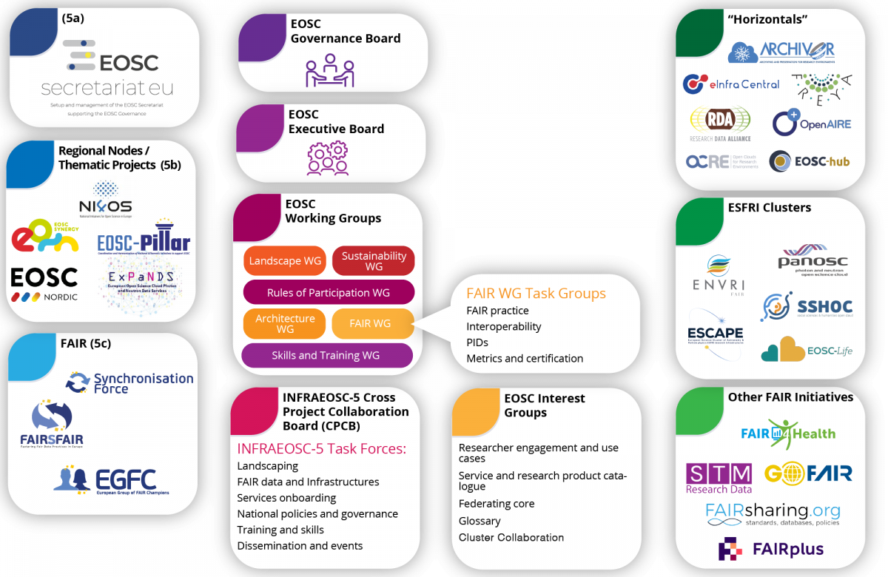
Primary stakeholders in the EOSC Ecosystem
Notes:
It is not just as easy as abc. There are no lines connecting these boxes because the reality is that the EOSC ecosystem is a complex network of actors and initiatives. Futhermore FAIR IS EVERYWHERE. The Synchronisation Force aims to provide beneficial input for the EOSC Working Groups, as well as the five ESFRI Clusters (PANOSC, SSHOC, ENVRI-FAIR, ESCAPE and EOSC-Life), and the other INFRAEOSC-5 projects, and Horizontal projects e.g. EOSChub and Freya. They are aided in this work by our Expert Group of FAIR Champions (EGFC) who act as ambassadors for FAIR in their own networks and communities.
I’ll show you the current members of the group and then I’ll introduce the Synch Force.

Slide 17
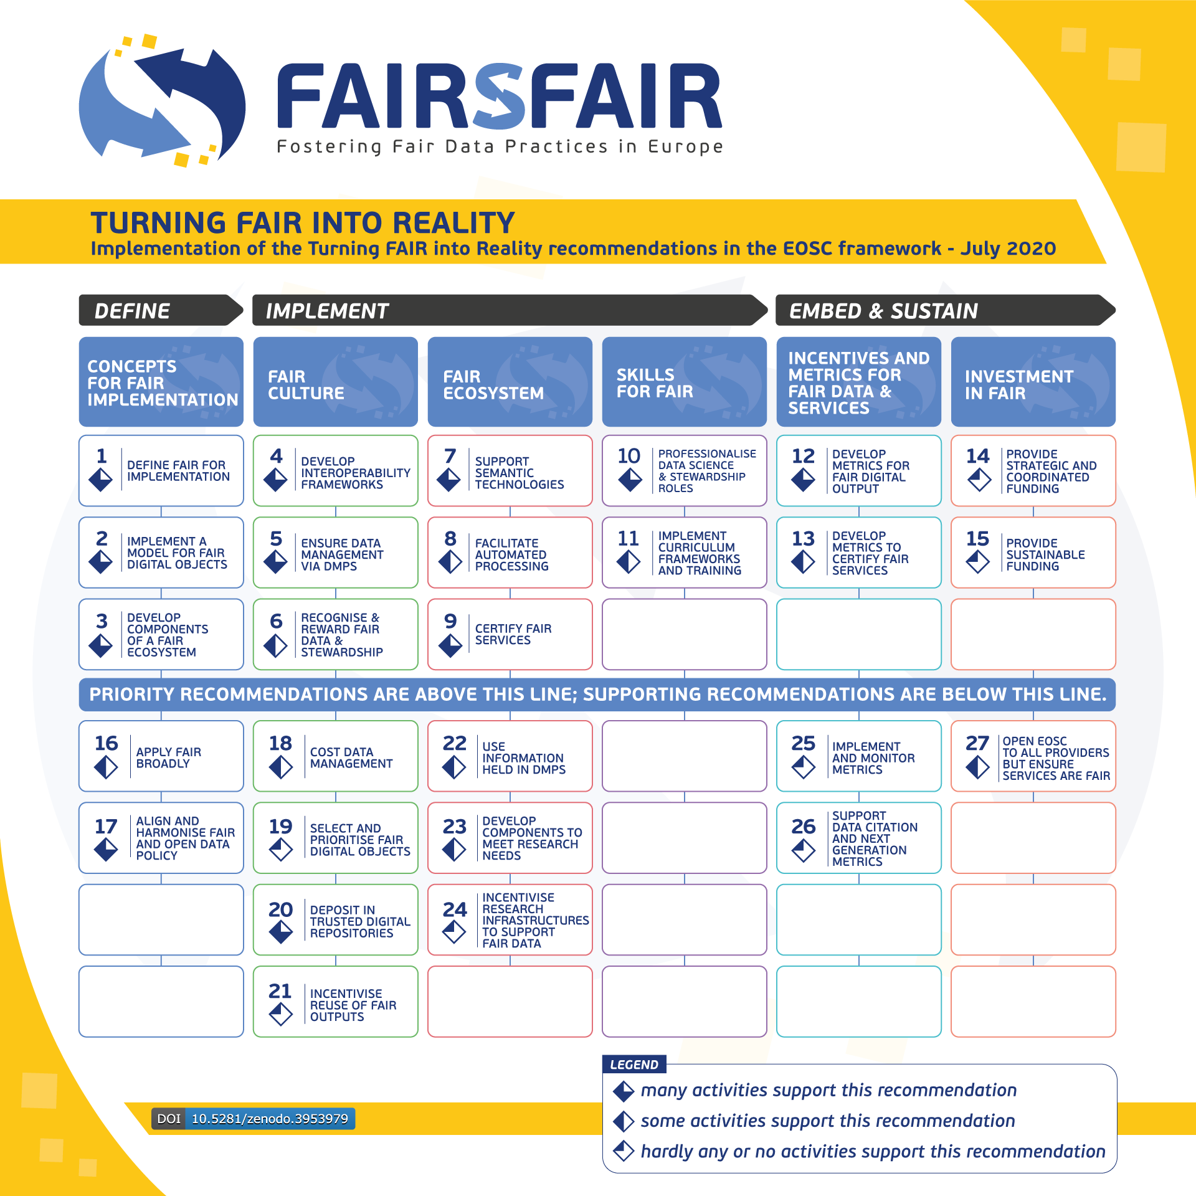
2nd Synchronisation Force Workshop
Den Haag, The Netherlands 29 April 2020
Ultimately held online between 29 April until 11 June 2020 as a series of eight sessions with EOSC Working Group representatives, partners in INFRAEOSC5 and ESFRI cluster projects, and members of the FAIRsFAIR European Group of FAIR Champions, the second workshop aimed to measure progress towards implementing the recommendations outlined in the Turning FAIR into Reality report.
► Access the full suite of workshop recordings and presentations.
► Read the full report
► Read the Summary Overview
Notes:
Another solution...the Synchronisation Force… It is an internal group in which all FsF WPs are represented.
...
The key activity of the SF is to organise three workshops. More about it in a minute. First a few words about other activities, because several SF members are involved in so-called TaskForces under the INFRAEOSC-5 Cross Project Collaboration Board.

Slide 18
FAIR Practices: Semantics, Interoperability and Services
FAIRsFAIR is developing technologies that support semantic interoperability in a sustainable way to develop FAIR practices.
The 2nd Report on FAIR requirements for persistence and interoperability builds on the landscaping exercise published in March 2020 which reviewed and documented the state of FAIR in the European scientific data ecosystem. The report identifies commonalities and possible gaps in semantic interoperability and the use of metadata and persistent identifiers across infrastructures. The new report has been written specifically for researchers, data stewards, and service providers, and is a guide to the use of PIDs, metadata, and semantic interoperability.
Contact: Jessica Parland-von Essen jessica.parland-vonessen@csc.fi
February 2020 Assessment report on FAIRness of services https://doi.org/10.5281/zenodo.3688762
March 2020 The 1st version of Recommendations for FAIR Semantics is developed https://doi.org/10.5281/zenodo.3707985
August 2020 2nd Report on FAIR requirements for persistence and interoperability describes the use of PIDs and metadata to enable FAIR data https://doi.org/10.5281/zenodo.4001631
The FAIR Data Point sandbox version is available
Assessment report on FAIRness of research software to be published
Contact: Jessica Parland jessica.parland-vonessen@csc.fi

Slide 19
FAIR Policy and Practice
The overall aim is to increase the production and use of FAIR data by supporting changes in policy and practice at funding body, repository and organisational levels.
FAIRsFAIR team are working with stakeholders to provide recommendations on how policies might be enhanced to support FAIR.
Collaboratively work to define recommendations and embed FAIR data practice in research culture
Develop a support programme to help repositories become more FAIR-enabling
February 2020 Policy Enhancement Recommendations https://zenodo.org/record/3686901
June 2020 Recommendations on practice to support FAIR data principles) https://zenodo.org/record/3924132
Coming up:
Proposal for metadata catalogue integration
Series of support events, guidance and reference materials
Contact: Joy Davidson Joy.Davidson@glasgow.ac.uk

Slide 20
FAIR Certification
FAIRsFAIR takes an iterative approach to consider how FAIR object assessment can be aligned with existing CoreTrustSeal requirements. This FAIR oriented elaboration of core Trustworthy Digital Repository (TDR) requirements provides input for the testing and revision of repository evaluation in the EOSC.
FAIR Objects → FAIRness evaluations of individual datasets. Use case based iterative approach building on existing work: researchers and data repositories
FAIR-enabling repositories → to support the co-development and implementation of certification schemes for data repositories, building on existing frameworks
FAIR object and data repository complementarity
Wider range of standard/assessment expectations (e.g. services, software, etc.) → keen to align and with other criteria that might be set for involvement in the EOSC, e.g. minimal technical standards.
As part of the FAIR Certification work there is the FAIRsFAIR support programme, where ten selected repositories have been selected to receive funding and support to obtain their CoreTrustSeal Certification. Certification Support Programme for FAIR Enabling Trusted Digital Repositories underway: blogpost (October 2020)
February 2020: FAIR objects: - Draft recommendations on requirements for FAIR datasets in trustworthy repositories https://zenodo.org/record/3678716
May 2020: FAIR-enabling repositories: Initial version of a repository certification mechanism: evaluations for CoreTrustSeal, implications for maturity modeling. Open to extensive engagement, feedback and iterations afterwards https://zenodo.org/record/3835698
August 2020 Further work on the FAIR Maturity work, building on this working paper
Upcoming: 19 November 2020 - Support workshop for the FAIR Certification Support programme, s
Contact: Ilona von Stein ilona.von.stein@dans.knaw.nl
Notes:
D4.2 This paper sets the work within the wider context of data infrastructures, describes the co-dependencies between (meta) data objects and their repository environment, and presents the developing mapping between requirements and principles. The evolving capability/maturity approach is explained and the design of a governed assessment and certification process is defined. This work will iterate alongside the wide range of ongoing data infrastructure initiatives to support a range of stakeholders on their journey towards trustworthy repository services that enable FAIR data. Extensive engagement and feedback are planned to allow us to reach this goal.

Slide 21
FAIR Competence Centre
“A shared hub of expertise in implementing FAIR data stewardship principles, offering leadership, coordination and cataloguing services to connect relevant people, guidance, learning resources and curricula”
Support a range of communities in their activities aimed at FAIR data uptake and compliance.
Promote harmonisation and coordination of efforts across communities, identifying opportunities for synergies and building on the progress of others. For example: contributing to development of Terms4FAIRskills terminology.
Dissemination, instruction and training. Delivering data stewardship training building on the CODATA-RDA Summer School for Research Data Science
Contact: Elizabeth Newbold elizabeth.newbold@stfc.ac.uk

Slide 22
FAIR Data Science and Professionalisation
Main outputs
Survey and report of FAIR data landscape (education, policies and support) at 90 universities across Europe: https://doi.org/10.5281/zenodo.3629682
Overview and analysis of existing competence frameworks and training initiatives: https://doi.org/10.5281/zenodo.4009006
Main activities
Focus groups held with 50 experts at University Carlos III of Madrid and the University of Amsterdam
Design Workshop for “FAIR Competence Framework for Higher Education”
Workshop on role of academic libraries in RDM and FAIR training: https://zenodo.org/record/3929098
Coming soon
FAIR Competence Framework (Q1/2021)
Series of capacity building workshops (Q2-4/2021)
Objectives
Map the integration of FAIR data principles in data science and other disciplines’ curricula and analyse the landscape of available FAIR data trainings in Europe.
Deliver a FAIR data competence framework for higher education and professionals to support the development of a FAIR data culture and the uptake of FAIR data principles.
Translate the competence framework into model curricula and university courses for different disciplines and professional profiles (e.g. data stewards)
Support embedding FAIR data education in university programmes and doctoral training through a series of workshops.
Contact: Lennart Stoy lennart.stoy@eua.eu

Slide 23
You as FAIRsFAIR ambassador
FAIRsFAIR in a Nutshell https://www.fairsfair.eu/fairsfair-nutshell
Useful materials for sharing & distribution
About FAIRsFAIR
FAIRsFAIR, Fostering FAIR Data Culture & Practices in Europe Flyer, March 2019
FAIRsFAIR main outputs. Infographics, September 2019
Embracing a FAIR Culture. FAIRsFAIR poster at the EOSC-Hub week. May 2020
FAIRsFAIR & EOSC infographic
FAIRsFAIR deposited outputs are periodically added to the FAIRsFAIR community on Zenodo
FAIRsFAIR Readings
FAIRsFAIR documents for community review
Deliverables and milestones
Presentations
Articles and blogposts
Newsletters
Other Outputs
For dissemination & social media share
FAIRsFAIR videos
FAIRsFAIR podcasts
Twitter channel
LinkedIn page
Youtube account
FAIRsFAIR standard logo (png)
FAIRsFAIR square logo (png)
FAIRsFAIR Software & Tools
FAIR Aware
FAIR Data Object Assessment Metrics
F-UJI

Slide 24




FAIRsFAIR in a Nutshell
October 2020
FOLLOW US
www.fairsfair.eu
@FAIRsFAIR_eu
www.linkedin.com/company/fairsfair/
www.youtube.com/channel/UCE4wSBnNIBfu6SqlBaIMfNg

